Slide 1

Probability Interactive Notebook
Name
Class
Teacher
Term 1 Semester 1
1

Slide 2
Contents
Glossary or Formula Page
Page
Date
Description
2
3

Slide 3
Tasks
24
7
30
Essential Question
Questions
Notes
Summary
4
5

Slide 4
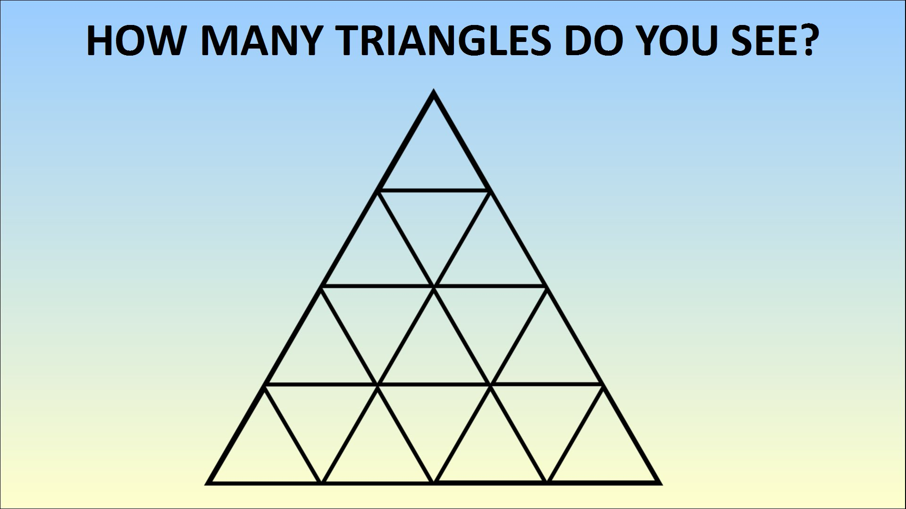

Slide 5
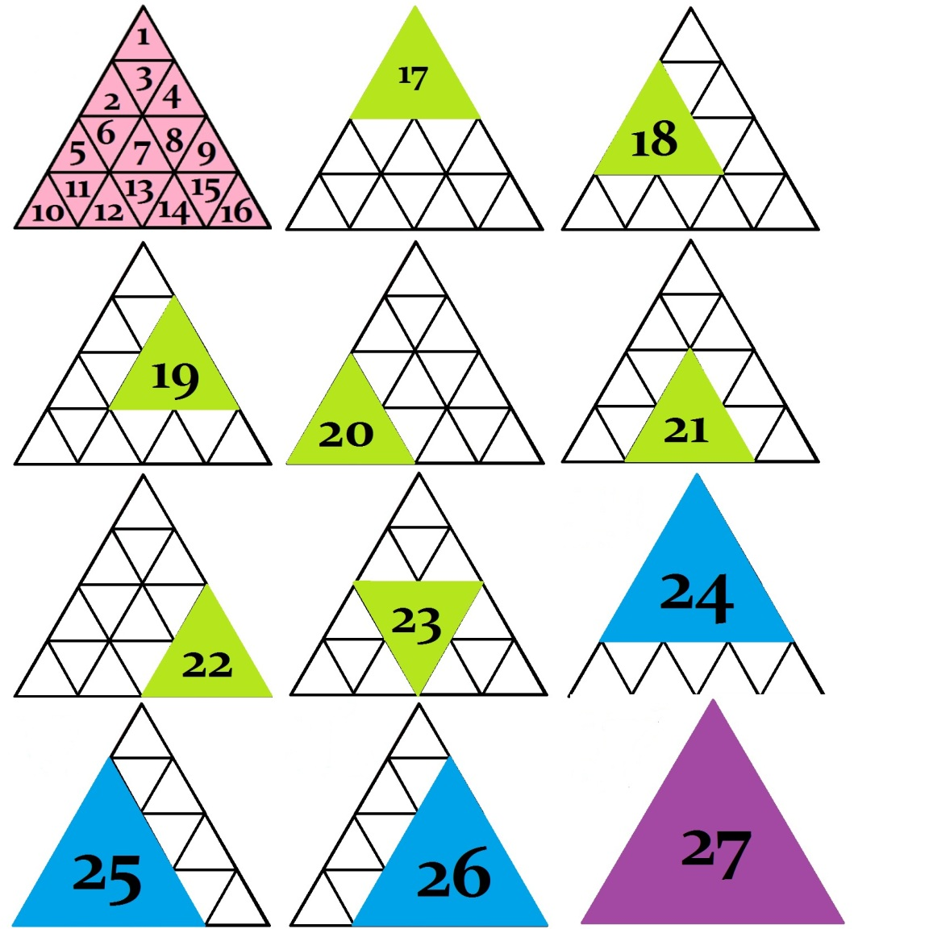

Slide 6
24
7
30
Date
Theoretical probability
EQ – What is the difference between experimental and theoretical probability?
What is theoretical probability?
Theoretical probability is the theoretical chance of an event occurring
What is Experimental Probability?
Experimental probability is the ratio of the number of times an event occurs to the total number of trials or times the activity is performed.

Slide 7
Copy and complete the table
Result | Theoretical Probability | Expected result from 30 rolls?
1
2
3
4
5
6
Expected result= theoretical probability x amount of trials

Slide 8
Experiment
Roll a di 30 times and record your results
event | tally | total | Experimental probability
1
2
3
4
5
6

Slide 9
Combine the results for the class
If we combine the results of the class (increase the number of trials), what do you think will happen to the experimental probability?
Think, Pair, Share

Slide 10
24
7
30
Date
Theoretical probability
EQ – What is the difference between experimental and theoretical probability?
What is theoretical probability?
Theoretical probability is the theoretical chance of an event occurring
What is Experimental Probability?
Experimental probability is the ratio of the number of times an event occurs to the total number of trials or times the activity is performed.
What happens when we increase the number of trials?
As we increase the number of trails the Experimental probability should get closer to the Theoretical probability

Slide 11
Quick review of the lesson
What is experimental probability?
What is theoretical probability?
How do we calculate theoretical probability
What happens to Experimental Probability when we increase the number of trials?
What is the difference between theoretical and experimental probability?

Slide 12
Homework
Review your notes and write a summary answering the essential question.

